Slide 1
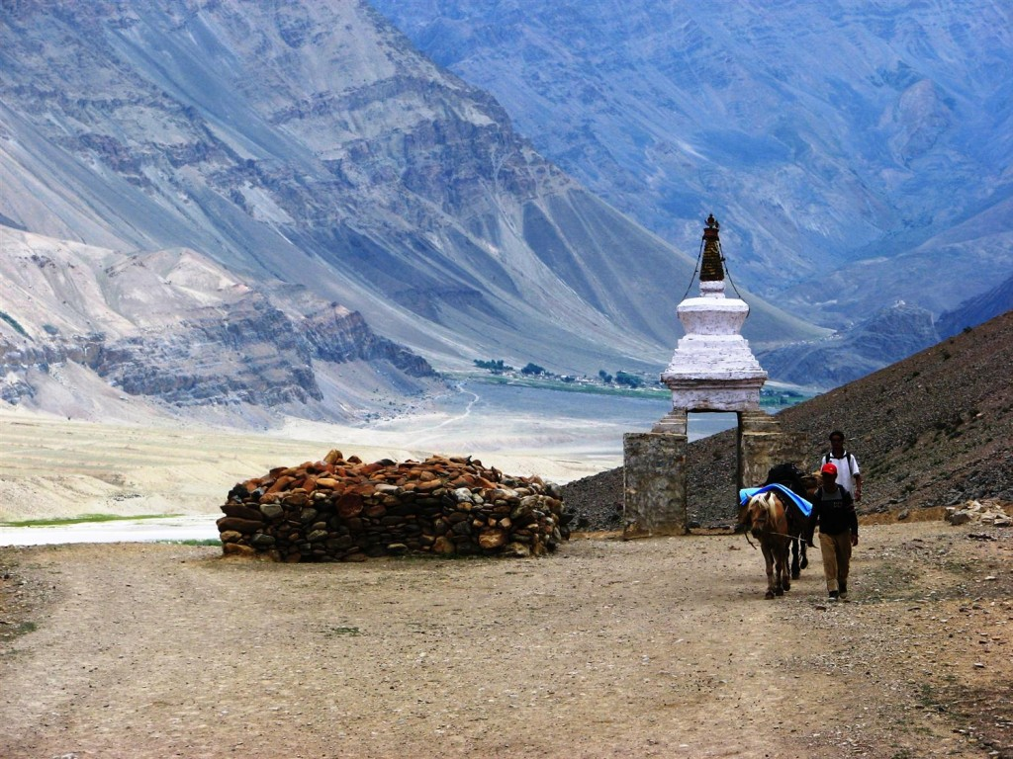
REMOTE HOMESTAYS

Slide 2
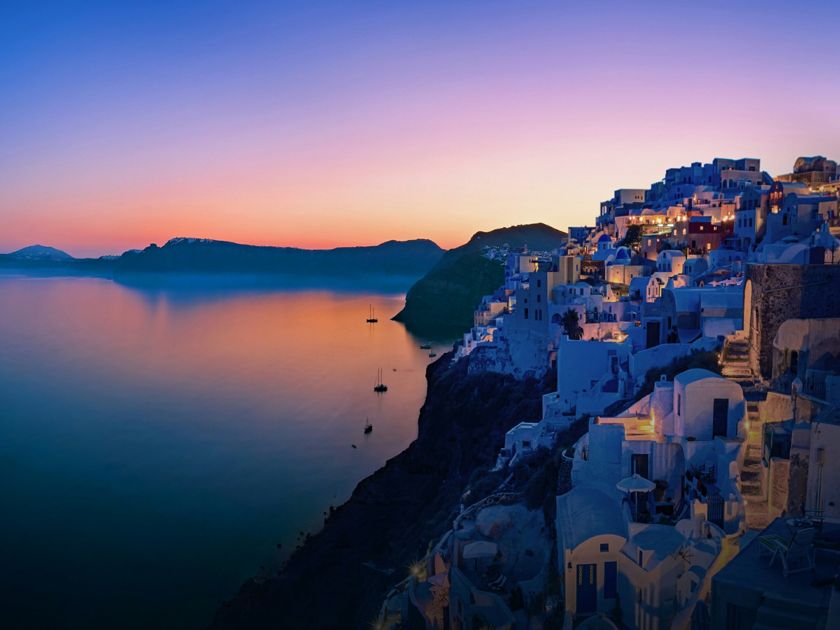
Remote Homestays
The culture of homestays is almost negligible in the
country. Our major aim is to provide homestays in remote
areas and tourist friendly places, such as Kaza, Spiti,
Mandi, Shekhawati, and other such places around
the country, which are less connected and are heavily
tourist visited.
The benefits of homestays is that it allows the tourist to
stay cheap, and can experience the culture of the place
firsthand. On the contrary, homestays provide the locals
to have a steady source of income through rent.

Slide 3

Security Issues
Anyone who wishes to host a homestay has to become a member of our portal. After than he’ll upload his Aadhar/Unique Identification number which shall be cross examined by our team. We have also deployed a chat bot which would allow the host and the tourist to interact before proceedings.
In future, we also have plans of providing traveler security insurances and work on similar tracks.

Slide 4


Initial Areas of Development

Slide 5
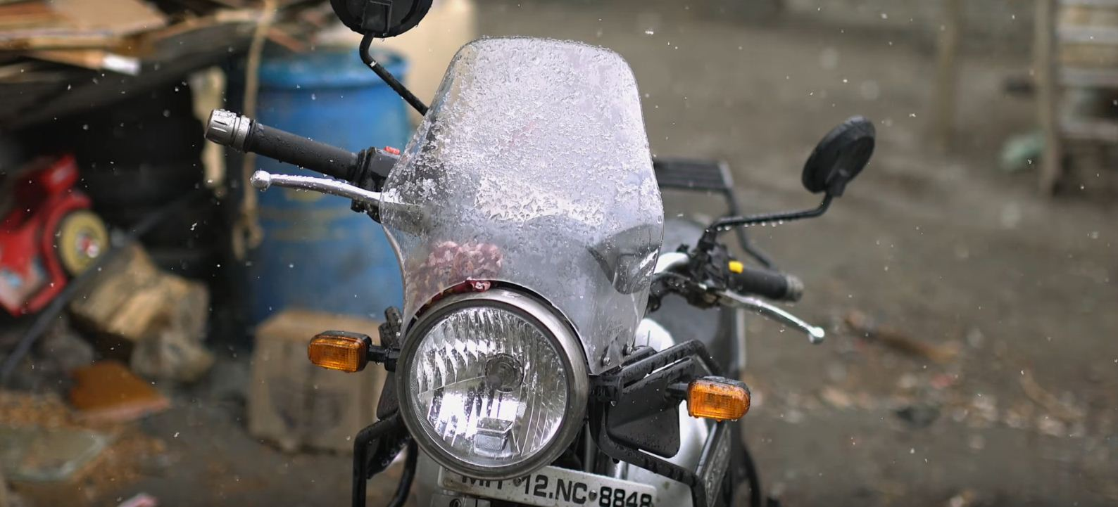
Vehicle Rentals
After the initial stages of development, we wish to provide
Vehicles on rent to the travelers through our portal. Currently,
Vehicle services are made available only in places like Manali,
Shimla and Mussoorie, we wish to extend this to even the
Other “not so mainstream” tourist spots like Patnitop,
Mcleodganj and Spiti.
We’ll contact the cab agencies and bike rental vendors in the
neighbouring town/city of the desired place and allow the
Tourist to get a bike/cab according to his need, in places which
do not have vehicles available.

Slide 6
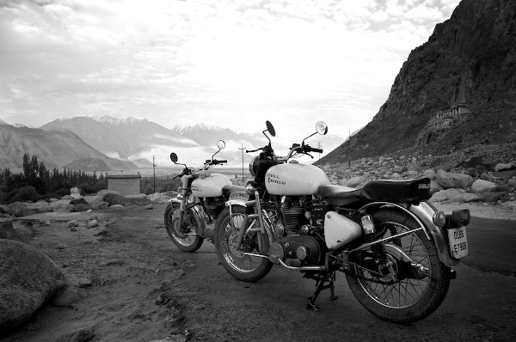
Vehicle Rental+
After the initial phases of development, we also wish to extend this feature, allowing the tourists to rent the vehicle of the locals or the host. But we’ll move onto this only after the initial stages of development and when the security measures are in place.

Slide 7
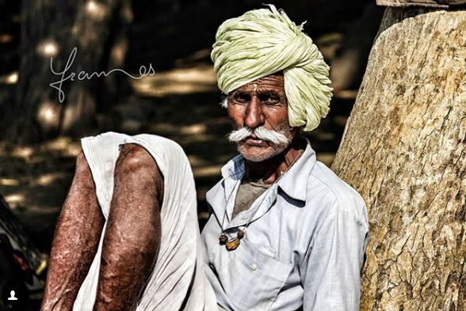
Travel Guides
Another major feature we’ll host is the provision
travel guides for the trip. Most local tour guides
cheat and overcharge the tourists, our portal
shall have experienced tour guides with their
details and services they’ll provide. Also, we’ll
allow the hosts to act as a tour guide for the
traveler.

Slide 8

Technologies Used
Front End
Back End
HTML
CSS
Bootstrap
Machine Learning
JAVA
JSP

Slide 9
Thank you
Team Sunrise
Hardik Maheshwari
Harsh Parashar
Arti Chauhan
Bhavishya Muradia

